Slide 1
S32G
PFE2 #1
S32G
PFE2 #2
Ingress port 6
Egress port 3
UMSD Command
---------------------------------------
vlan findEntry 1
vlan delEntry 1
vlan addEntry -fid 0x1 -vid 0x1 -TagP {3 3 3 2 3 3 2 3 3 3}
port setQMode 3 2
port setQMode 6 2
atu delAll 1
atu addEntry -macAddr 0001BEBEEF33 -state 0xb -fid 0x1 -portVec 0x08 -Qpri 0x2
88Q5192
#1
88Q5192
#2
100base-t1
Capture
Module

Slide 2
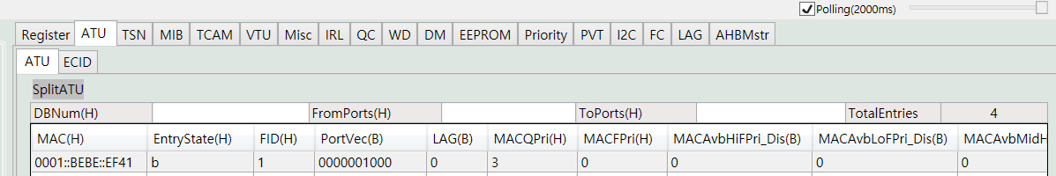
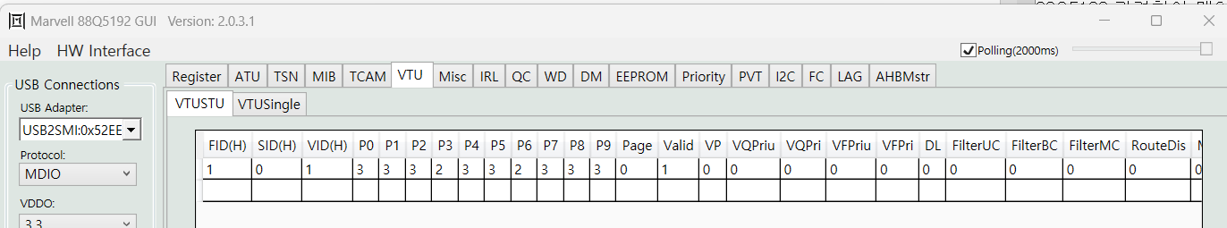
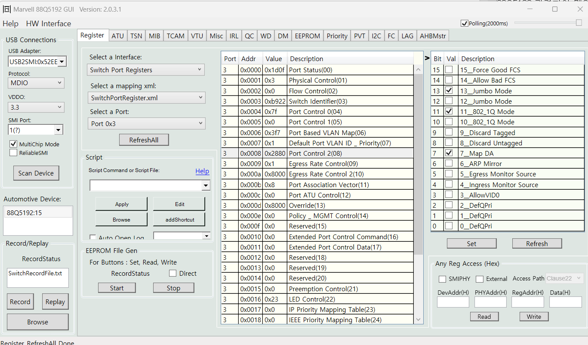
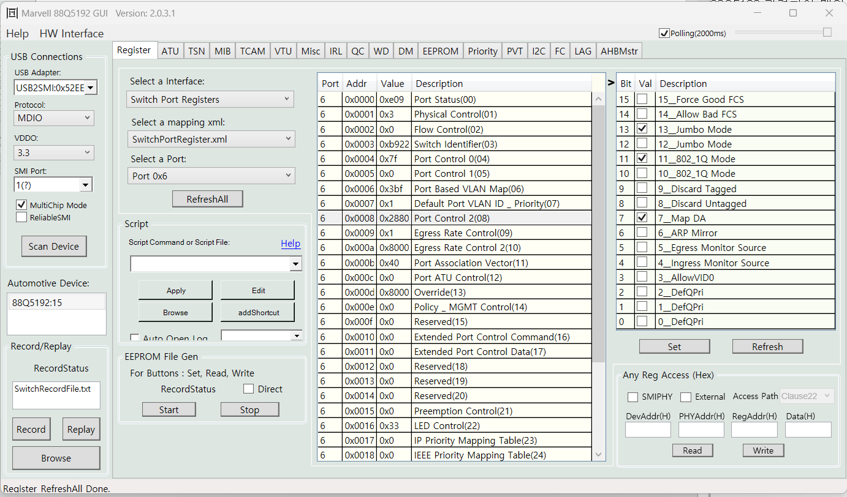
atu addEntry -macAddr 0001BEBEEF41 -state 0xb -fid 0x1 -portVec 0x08 -Qpri 0x2
vlan addEntry -fid 0x1 -vid 0x1 -TagP {3 3 3 2 3 3 2 3 3 3}
port setQMode 3 2
port setQMode 6 2

Slide 3
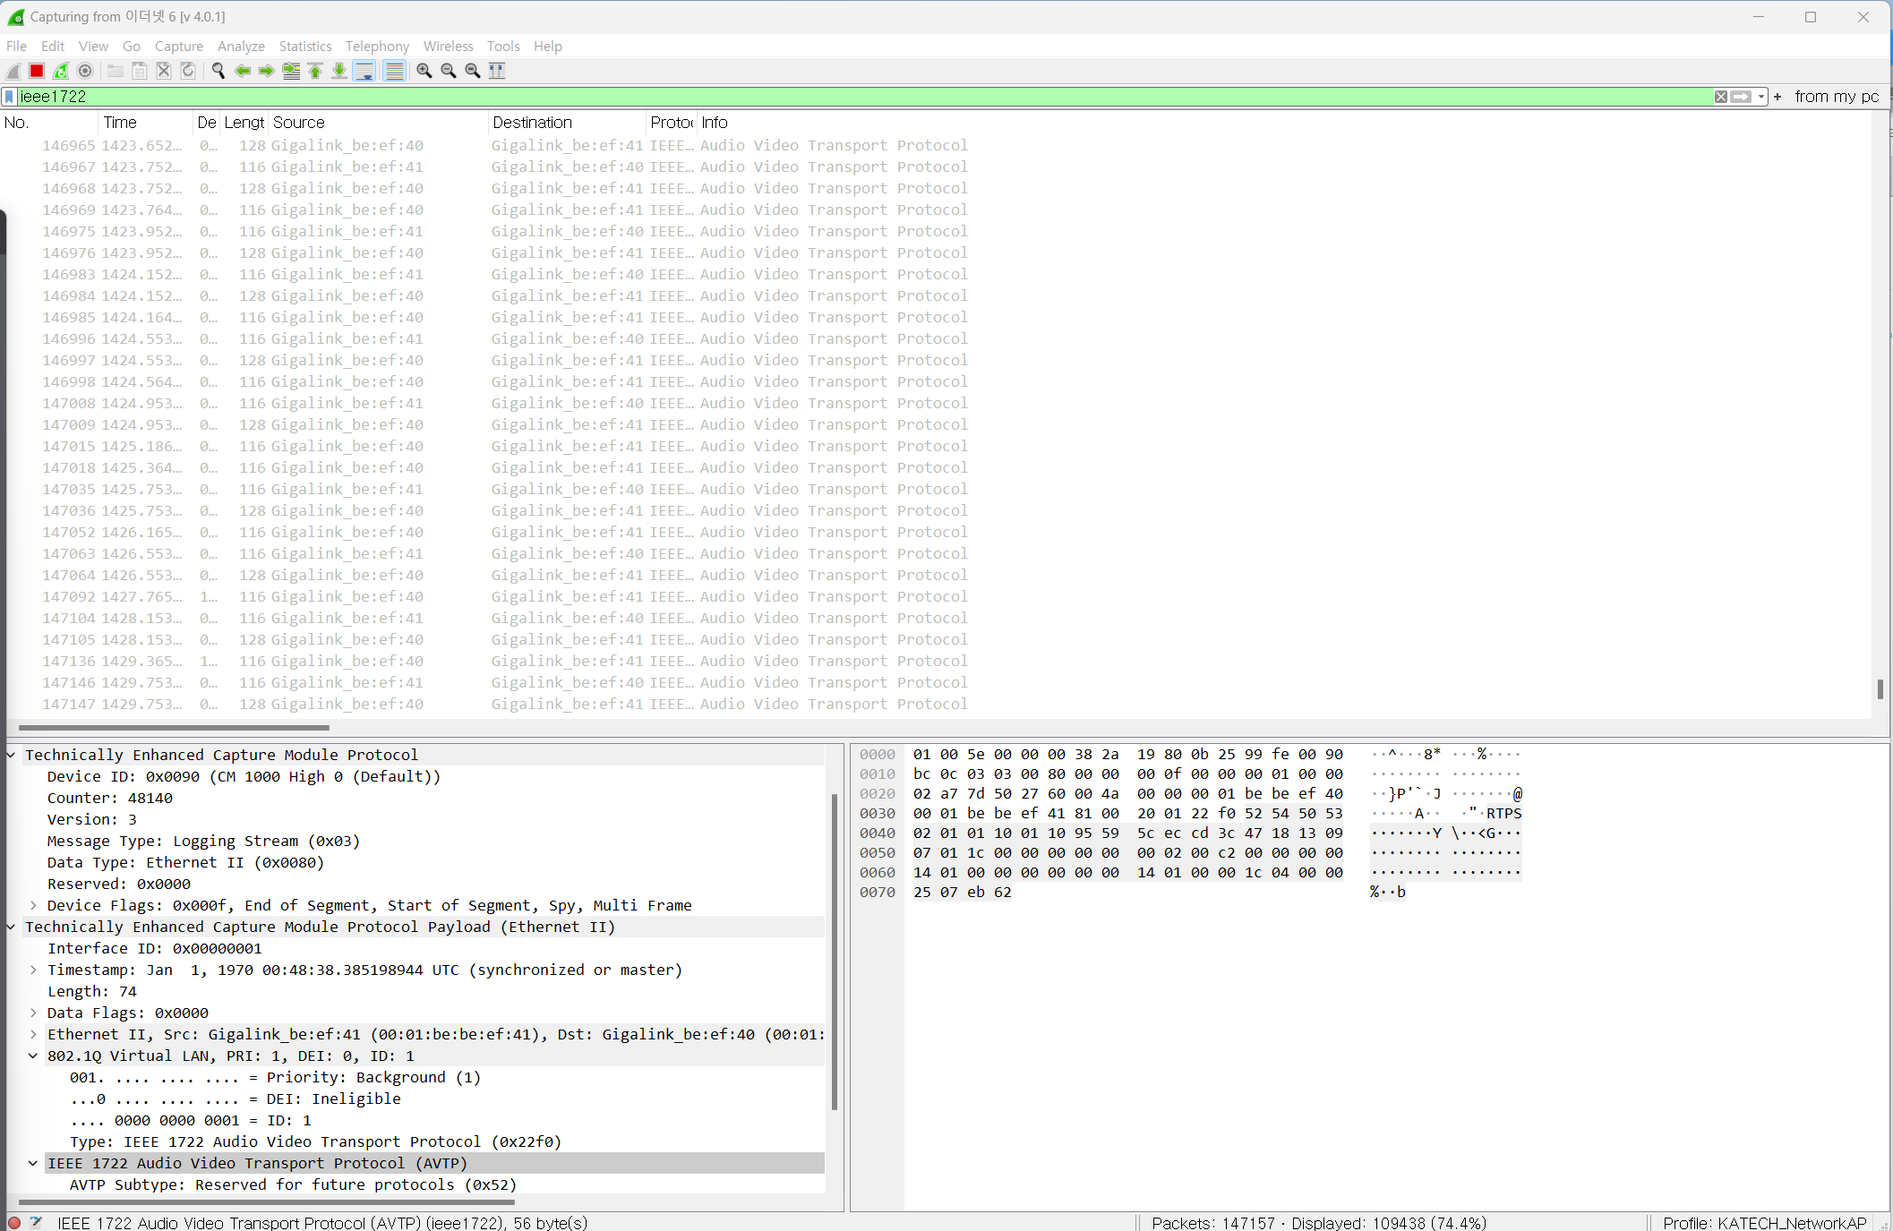
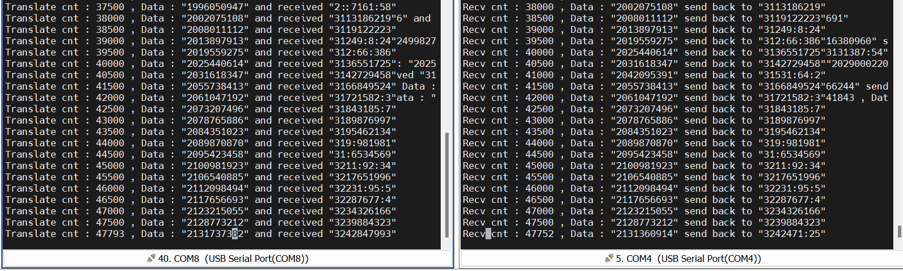
Packet 및 동작캡처

Slide 4
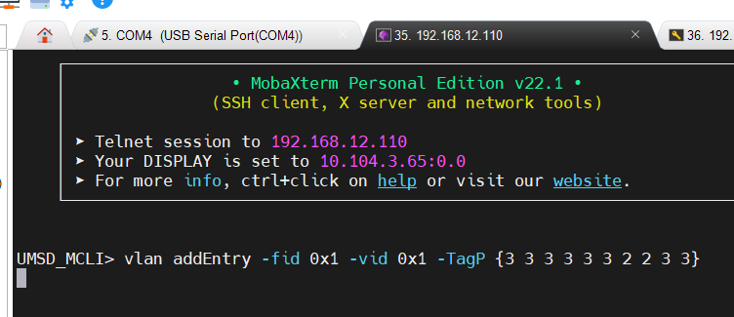
UMSD Error
명령어 입력 후 정지

